Slide 1

WAY TO ENTERPRISE
AWS
VTI ACADEMY
Author: duy.nguyenngoc1@vti.com.vn

Slide 2
Agenda
Elastic Load Balancing Service
Auto Scaling Group Service
Assignments
Quiz
Copyright © VTI Academy All Rights Reserved

Slide 3
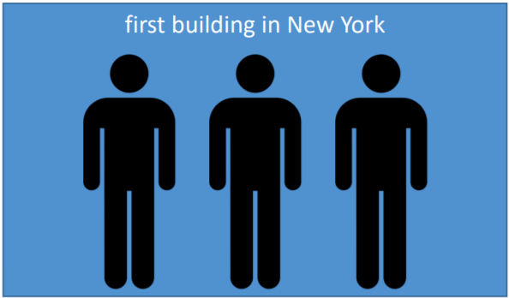
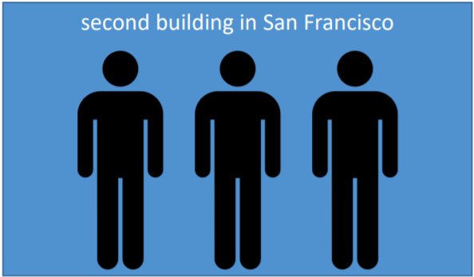
High Availability
High Availability
Means running your application / system in at least 2 data centers (2 Availability Zones)
Usecases: survive a data center loss

Slide 4
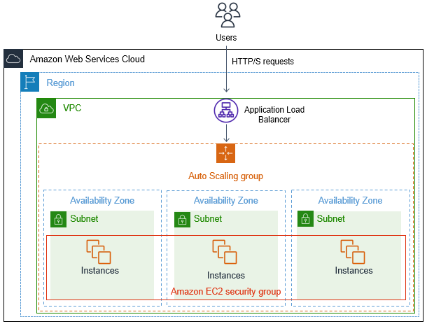
High Availability
High Availability for EC2
Run instances for the same application across multi AZ
Auto Scaling Group multi AZ
Load Balancer multi AZ

Slide 5
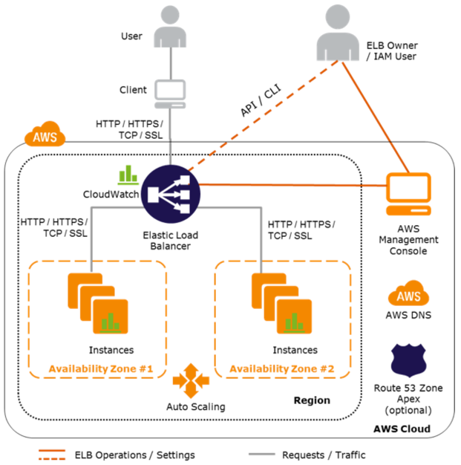
Elastic Load Balancing Service
Automatically distribute traffic from the client to many different targets on more zones for processing
Regional service
Price: https://aws.amazon.com/elasticloadbalancing/pricing
Tutorial: https://docs.aws.amazon.com/elasticloadbalancing/latest/userguide/what-is-load-balancing.html

Slide 6
Elastic Load Balancing Service
Demo 1 (Application Load Balancer)
Launch 2 instances in 2 zones (same VPC)
Create Target Group
Create Security Group for Load Balancer
Create Load Balancer
Test

Slide 7
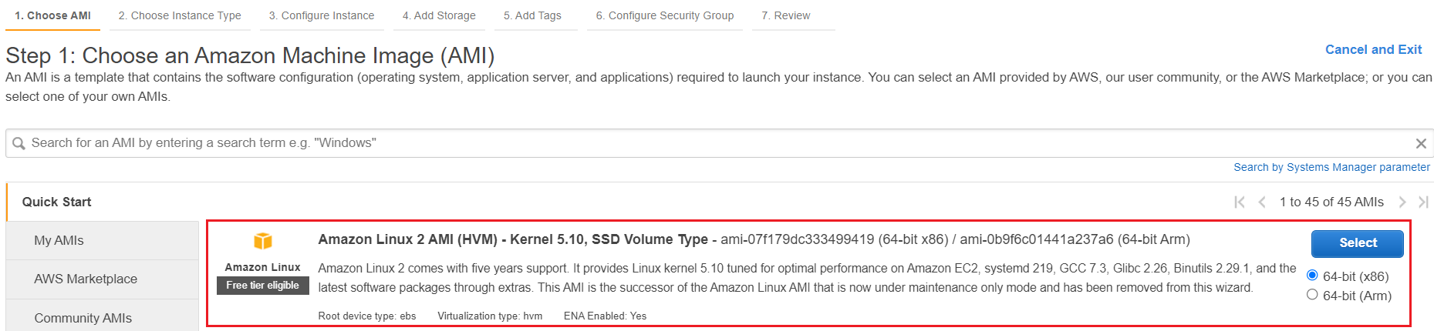
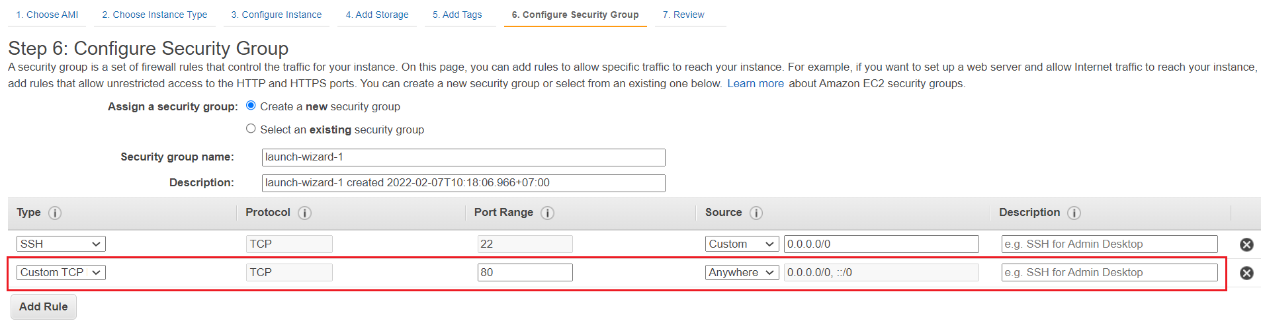
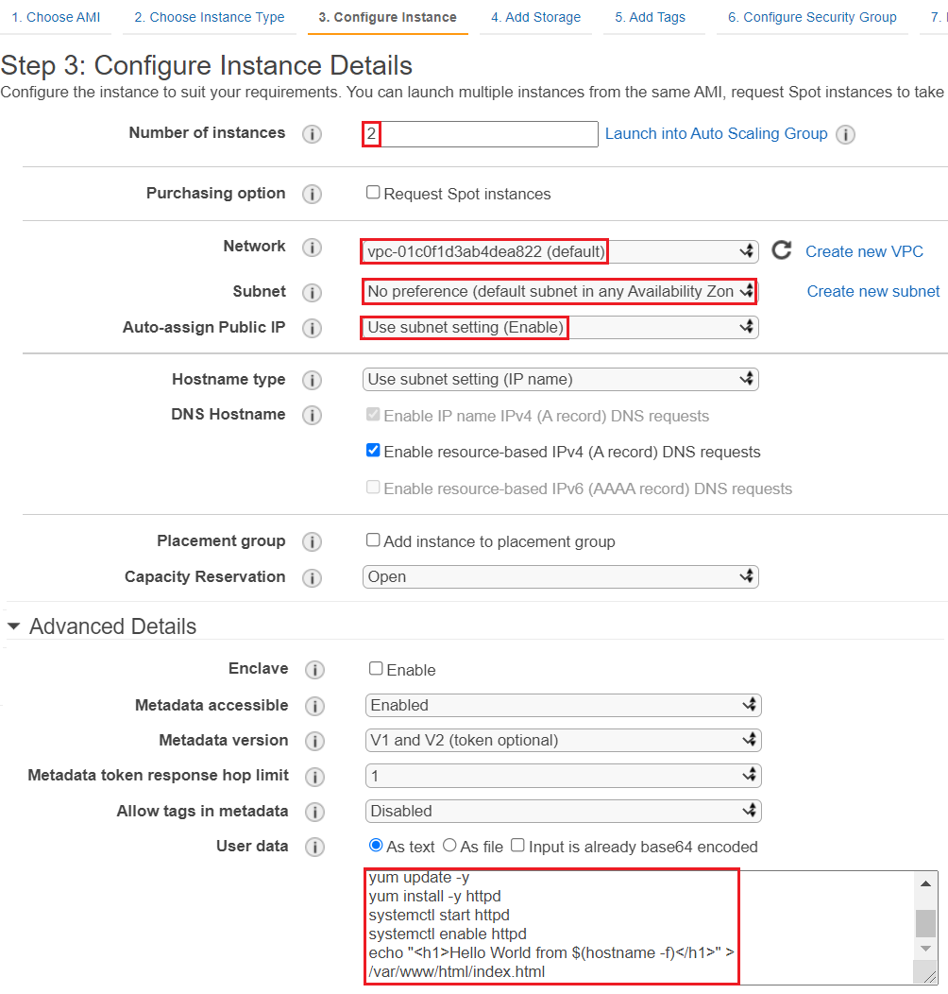
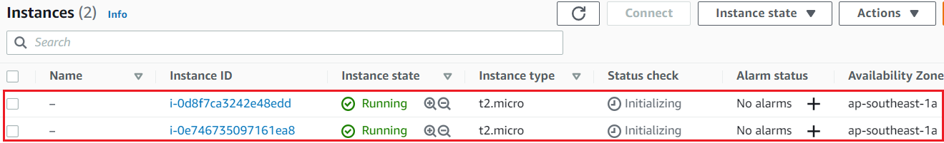
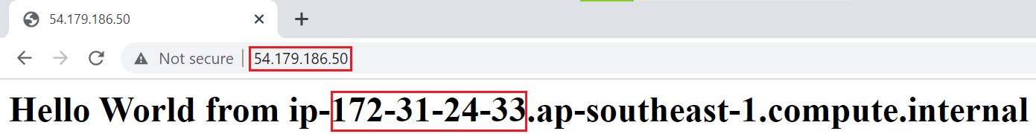
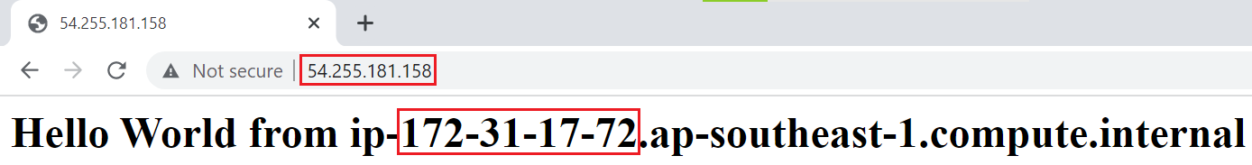
Elastic Load Balancing Service
Launch 2 instances in 2 zones (same VPC)

Slide 8
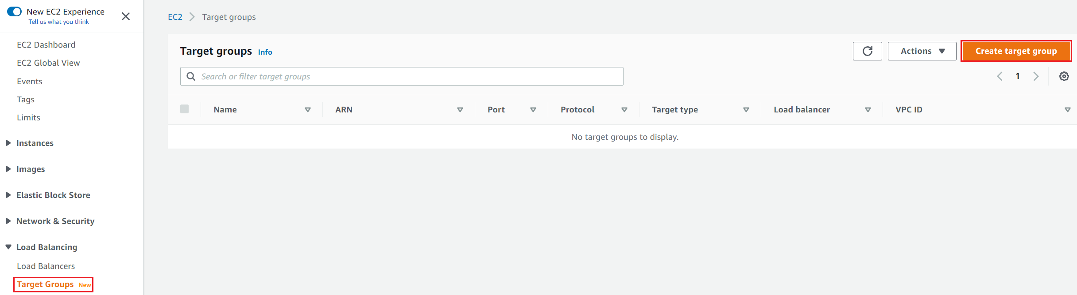
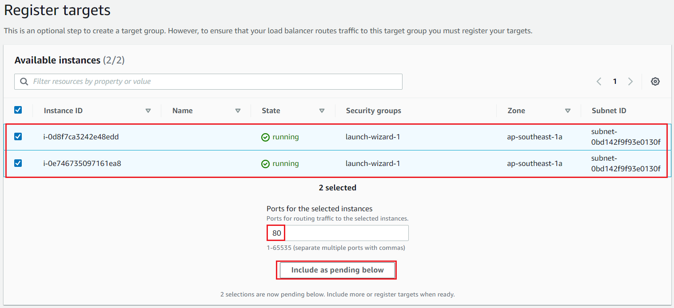
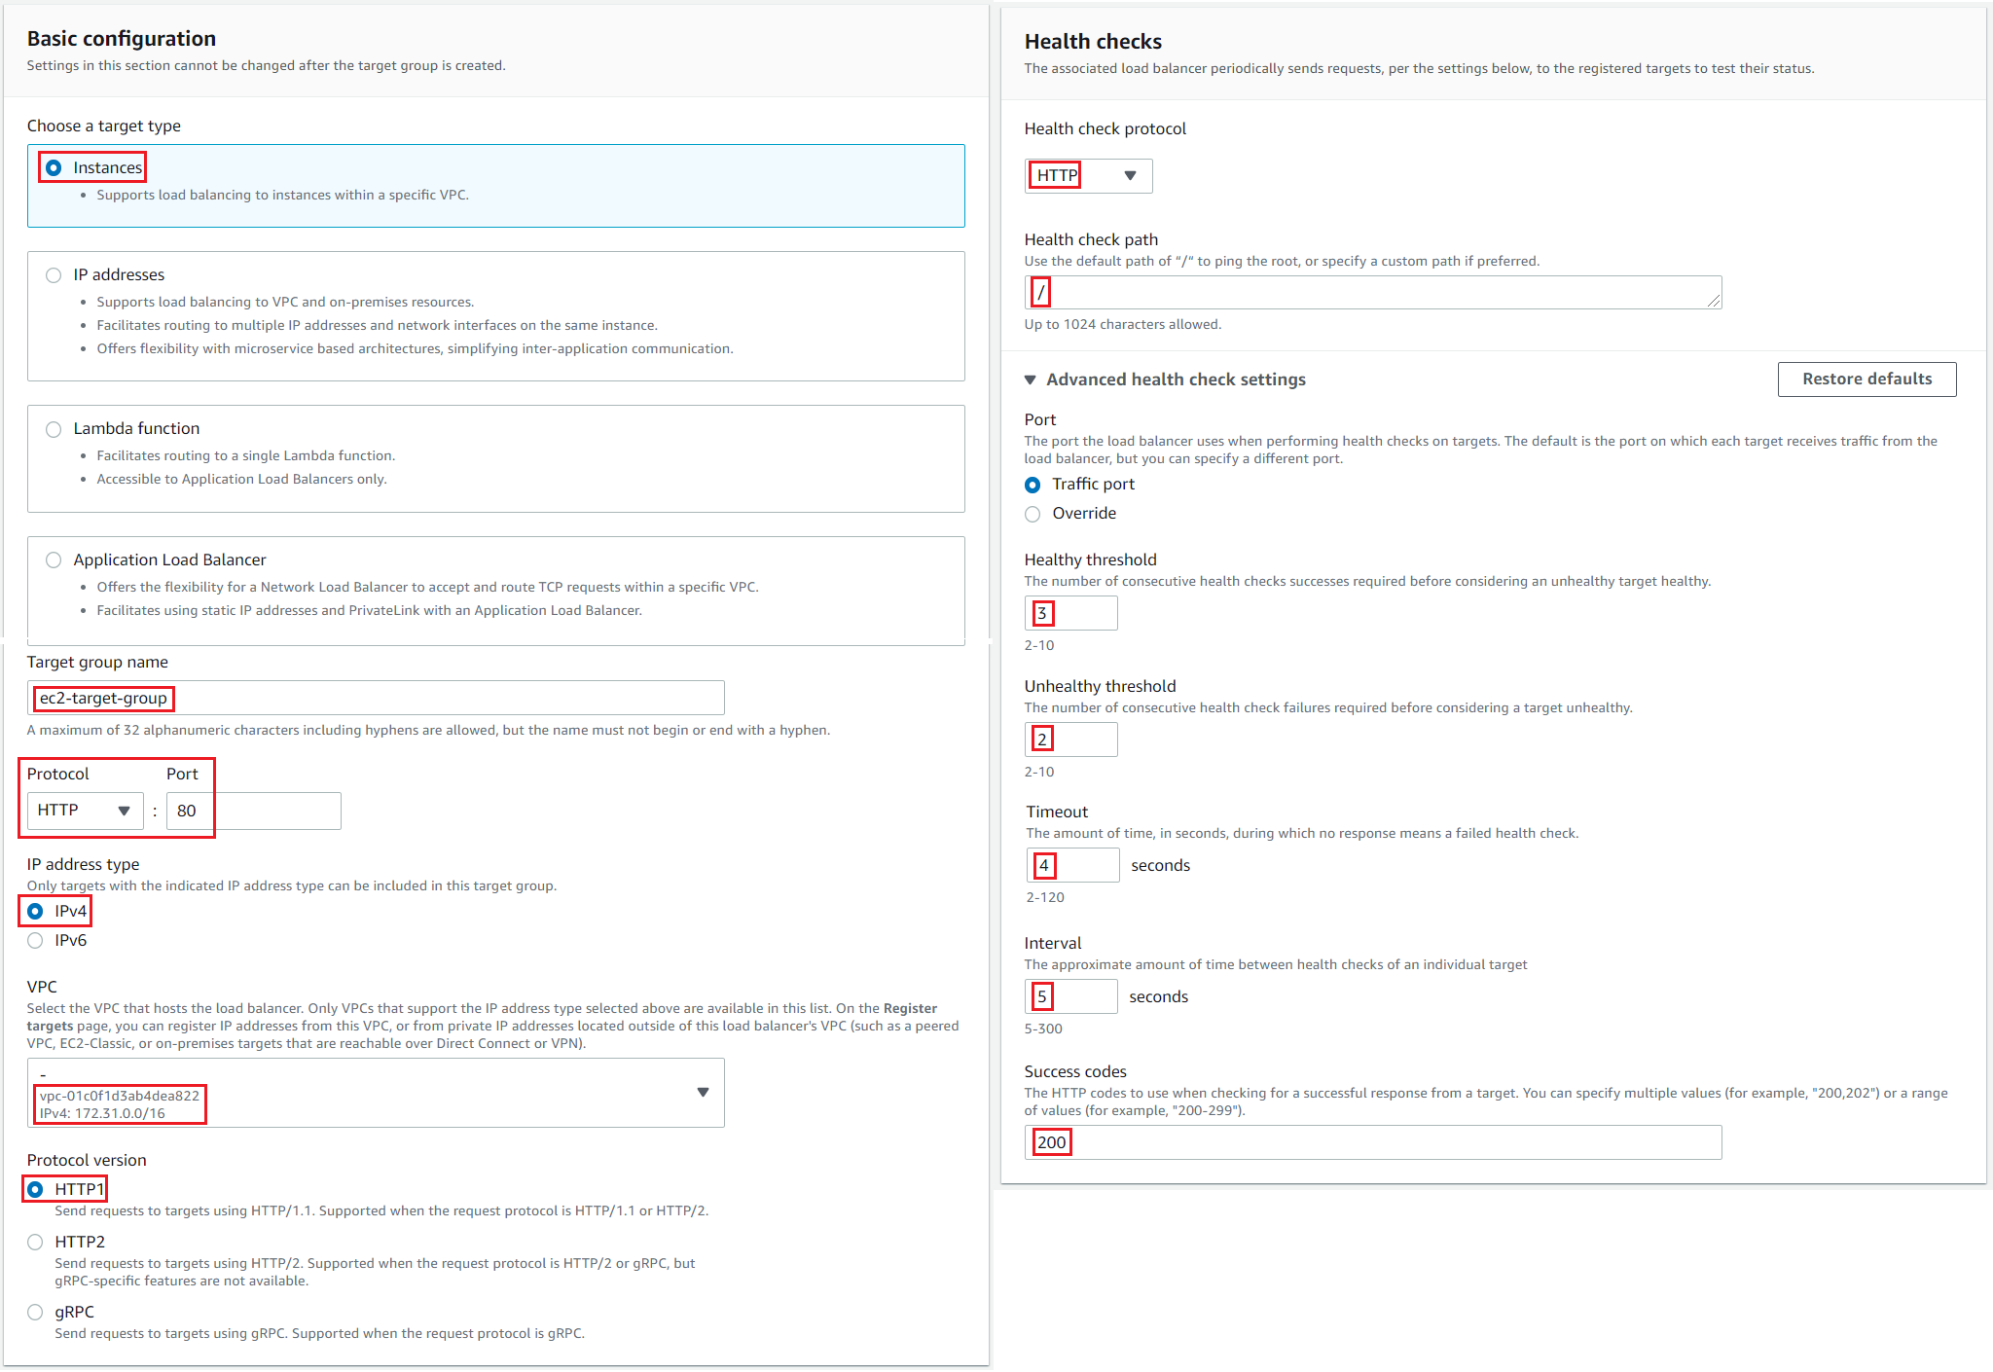
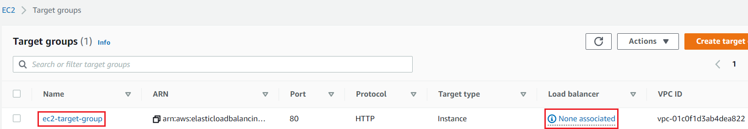
Elastic Load Balancing Service
Create Target Group

Slide 9
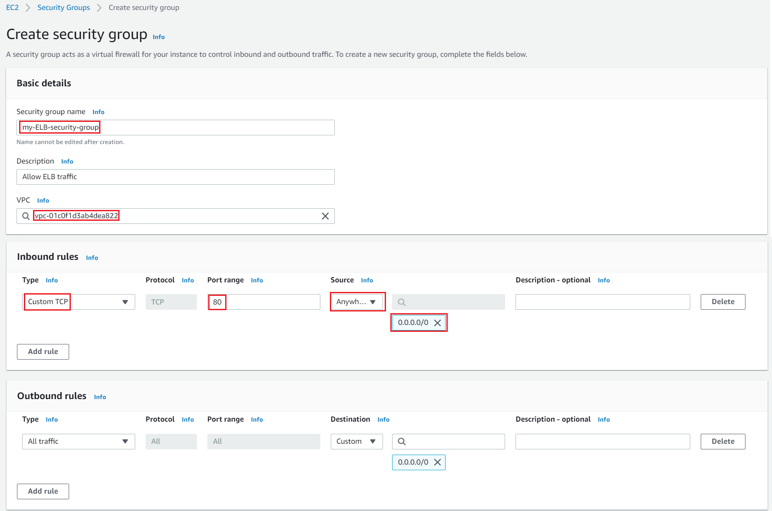
Elastic Load Balancing Service
Create Security Group for Load Balancer

Slide 10
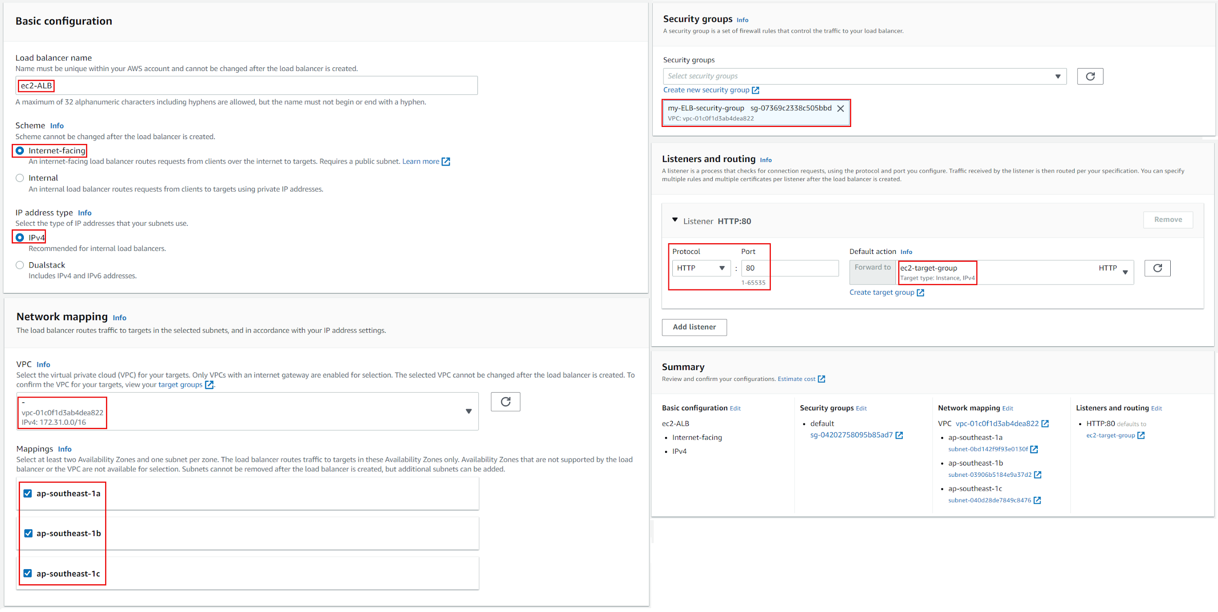
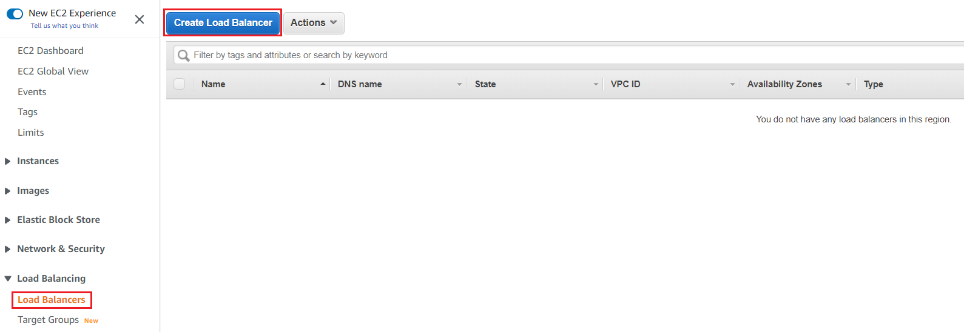
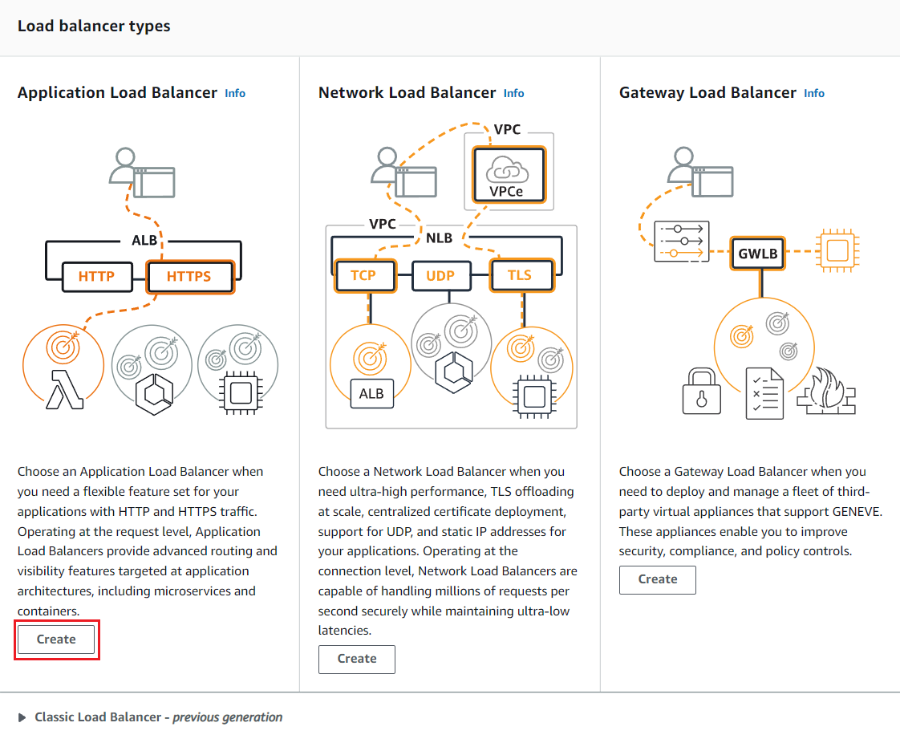
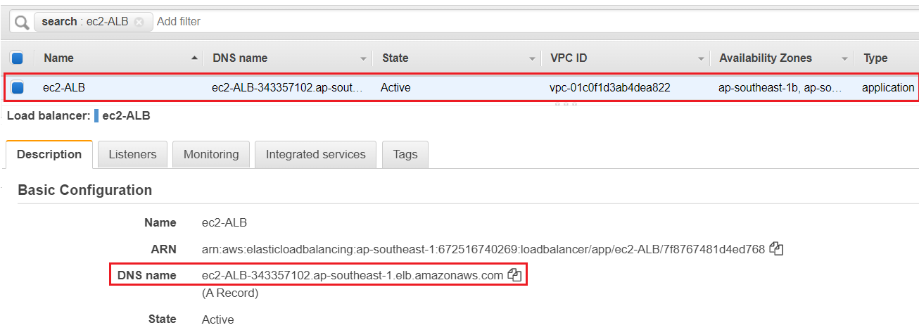
Elastic Load Balancing Service
Create Load Balancer

Slide 11
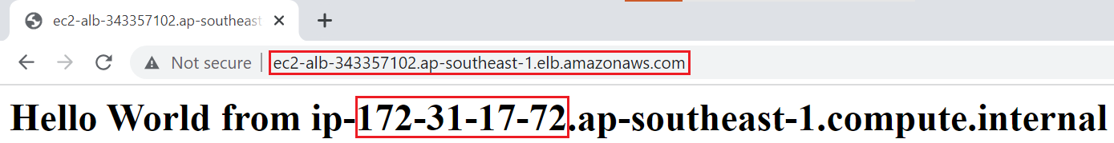
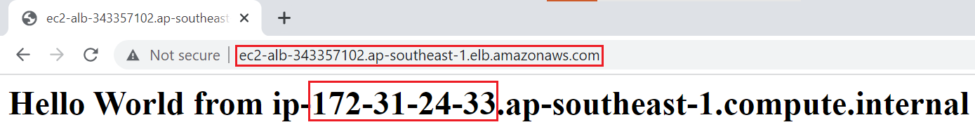
Elastic Load Balancing Service
Test

Slide 12
Assignment
Self-practice

Slide 13
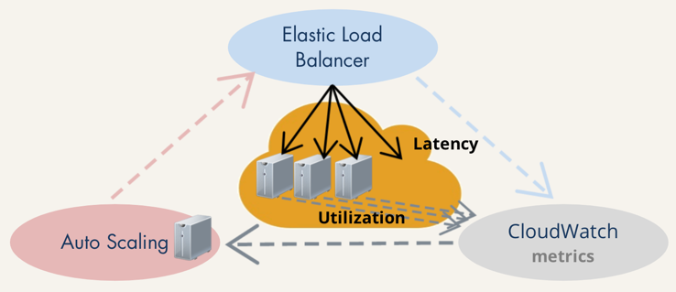
Elastic Load Balancing Service
You can change the number of targets at will, at any time
Must be launched in multiple zones (at least 2 zones)
Can be combined with other services: Global Accelerator, Route 53, CloudWatch, WAF, Auto Scaling Group, ...

Slide 14
Elastic Load Balancing Service
Types
Classic Load Balancer (CLB) (v1 - old generation) – 2009
Application Load Balancer (ALB) (v2 - new generation) – 2016
Network Load Balancer (NLB) (v2 - new generation) – 2017
Gateway Load Balancer (GLB) – 2020

Slide 15
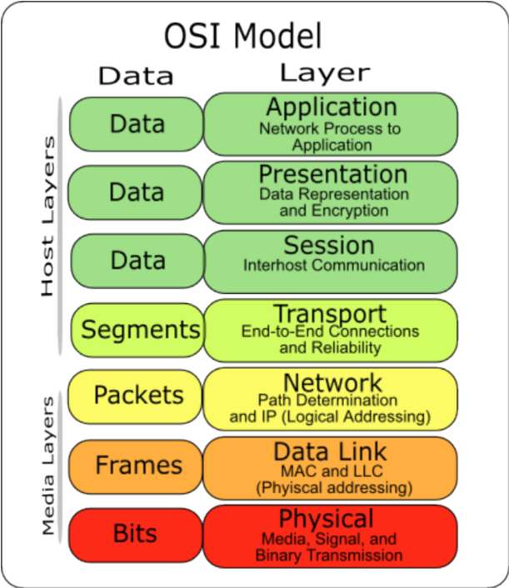
Elastic Load Balancing Service
Application Load Balancer (ALB)
Working at layer 7 - application layer of OSI Model (HTTP/HTTPS)
No fixed IP 🡺 config accessing via domain
The IP address of the incoming client request will change as it passes through the ALB
Usecases: Web Application, Microservices, …
OSI Model Tutorial: https://medium.com/containers-on-aws/using-aws-application-load-balancer-and-network-load-balancer-with-ec2-container-service-d0cb0b1d5ae5

Slide 16
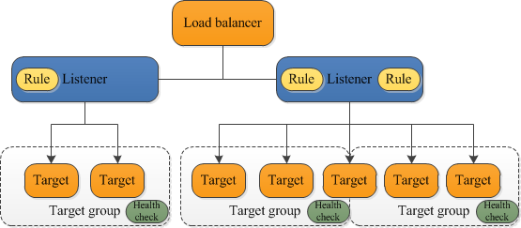
Elastic Load Balancing Service
Components
Load balancer
Listener
Target group
Target

Slide 17
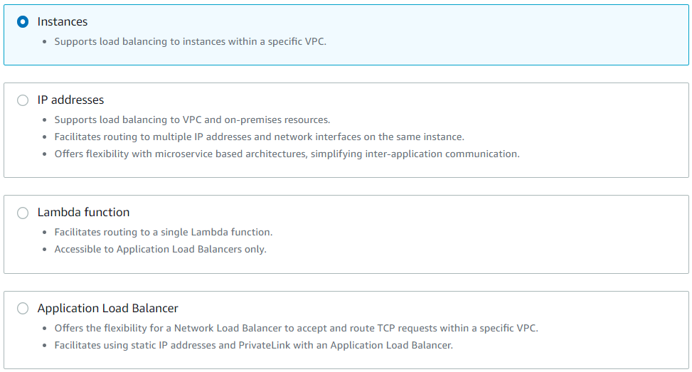
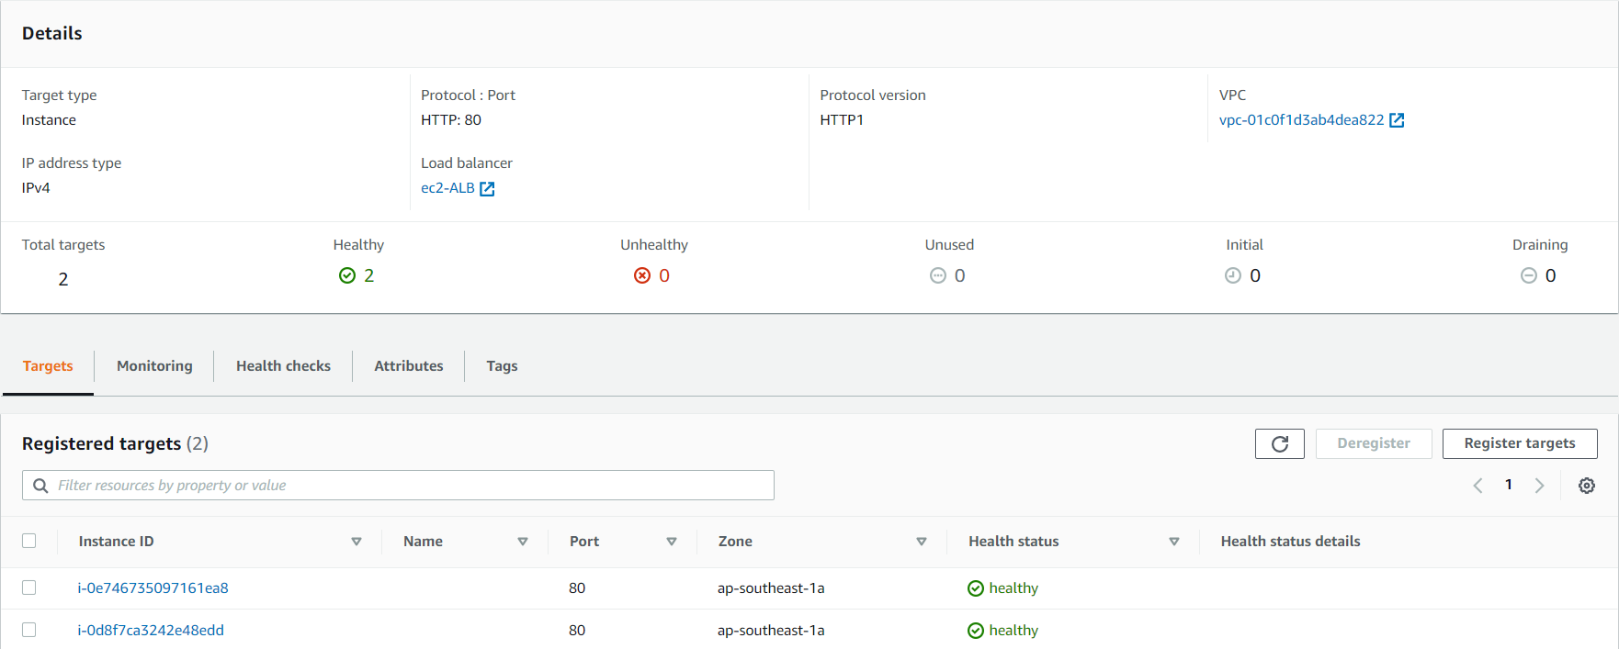
Elastic Load Balancing Service
Target
Is EC2 instances, IP addresses (DNS), Lambda functions
Target group
Contain multiple targets (protocol & port target)
Can add, remove targets without interrupting the application
Target Type

Slide 18
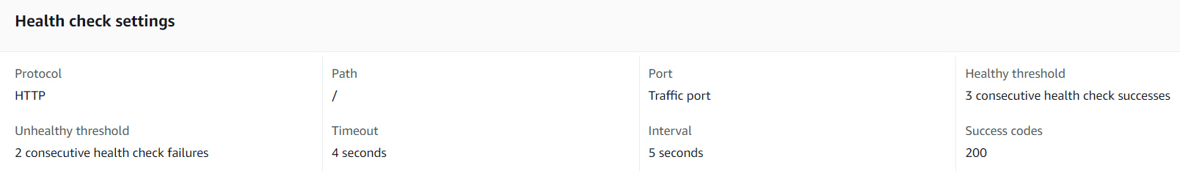
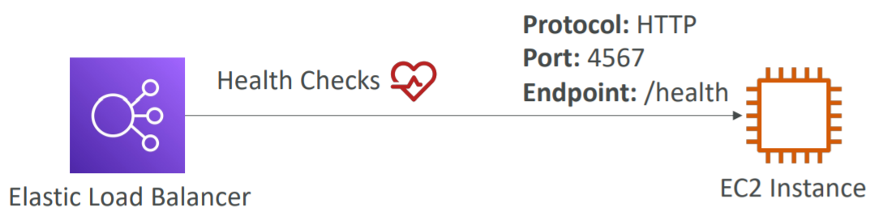
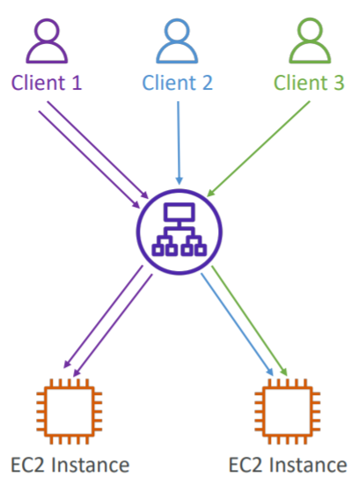
Elastic Load Balancing Service
Health check: monitoring health of targets, load balancer only sends traffic to healthy target
Health check
Load balancing algorithm: Round robin (default), Least outstanding requests
Sticky Sessions (Session Affinity)
Save session used in EC2s (To avoid the case that you are logging in to instance A, but the next time you request, the load balancing will switch to instance B 🡺 losing session)
It is possible to implement stickiness so that the same client is always redirected to the same instance behind a load balancer
Usecases: Stateful System (make sure the user doesn’t lose his session data)
Rarely used 🡺 Design according to Stateless System

Slide 19
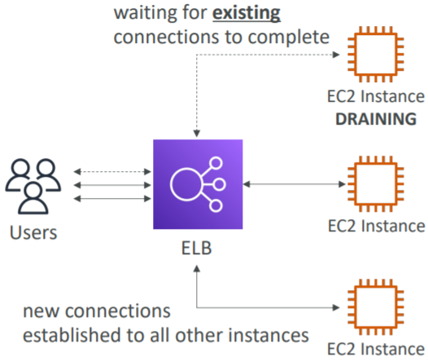
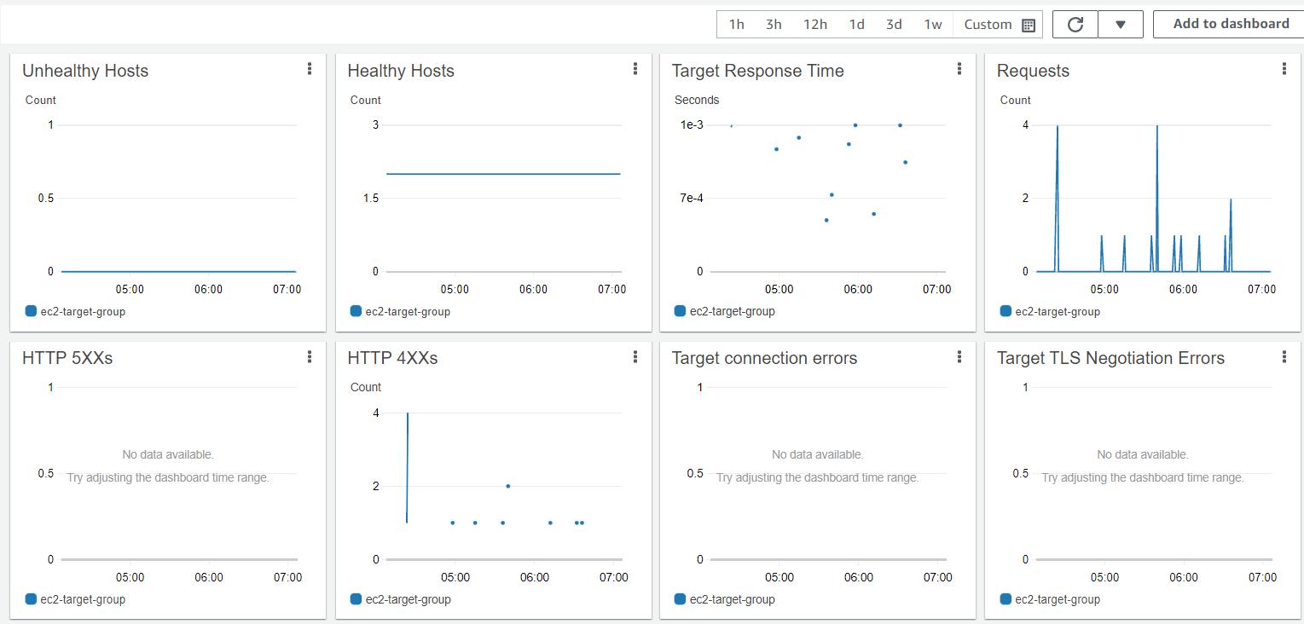
Elastic Load Balancing Service
Deregistration delay
Time to complete “in-flight requests” while the instance is de-registering or unhealthy
Stops sending new requests to the EC2 instance which is de-registering
Monitoring targets

Slide 20
Elastic Load Balancing Service
Listener
Demo 2
Launch 2 image instances & 2 video instances in 2 zones (same VPC)
Create image & video Target Group
Create Load Balancer
Test

Slide 21
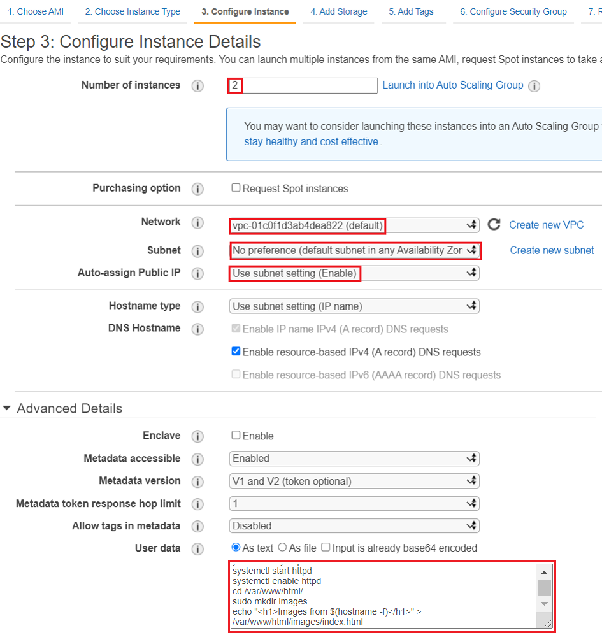
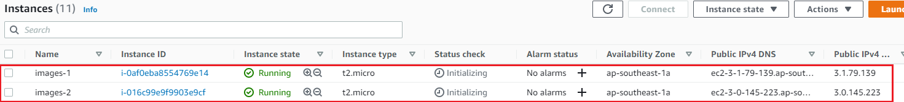


Elastic Load Balancing Service
Launch 2 image instances & 2 video instances in 2 zones (same VPC)
2 Image instances

Slide 22
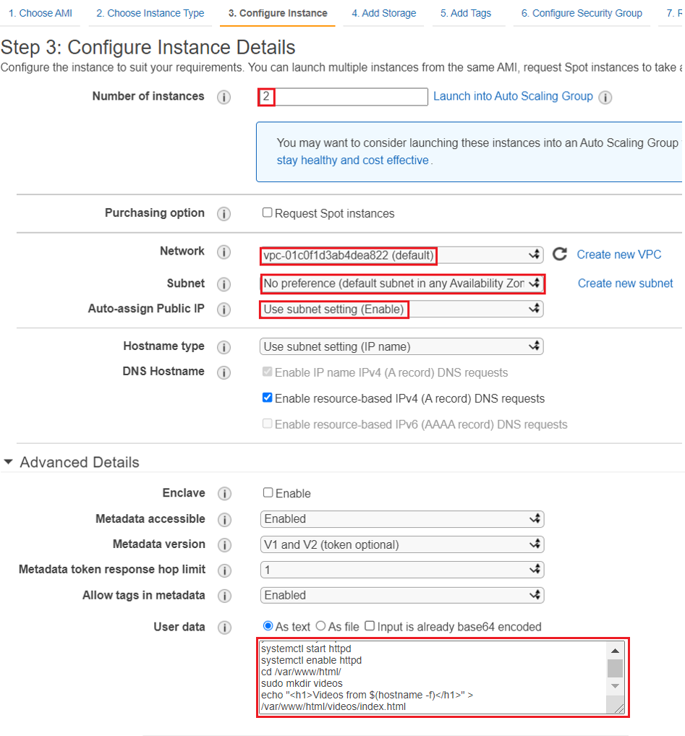
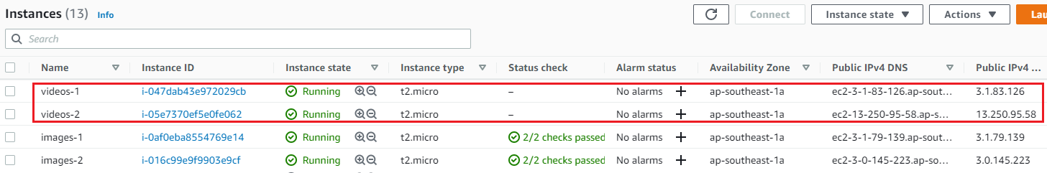
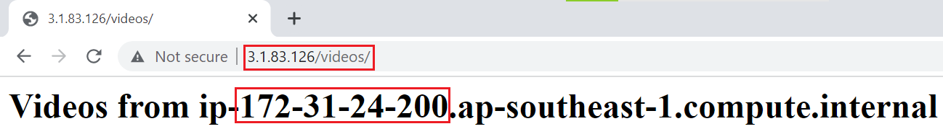
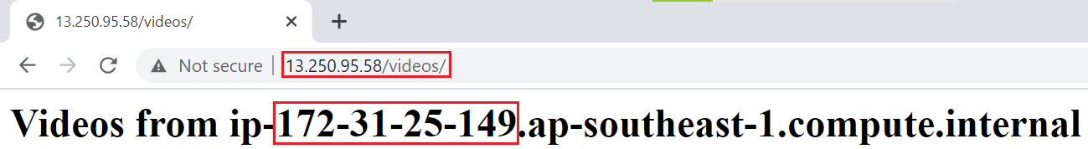
Elastic Load Balancing Service
2 Video instances

Slide 23
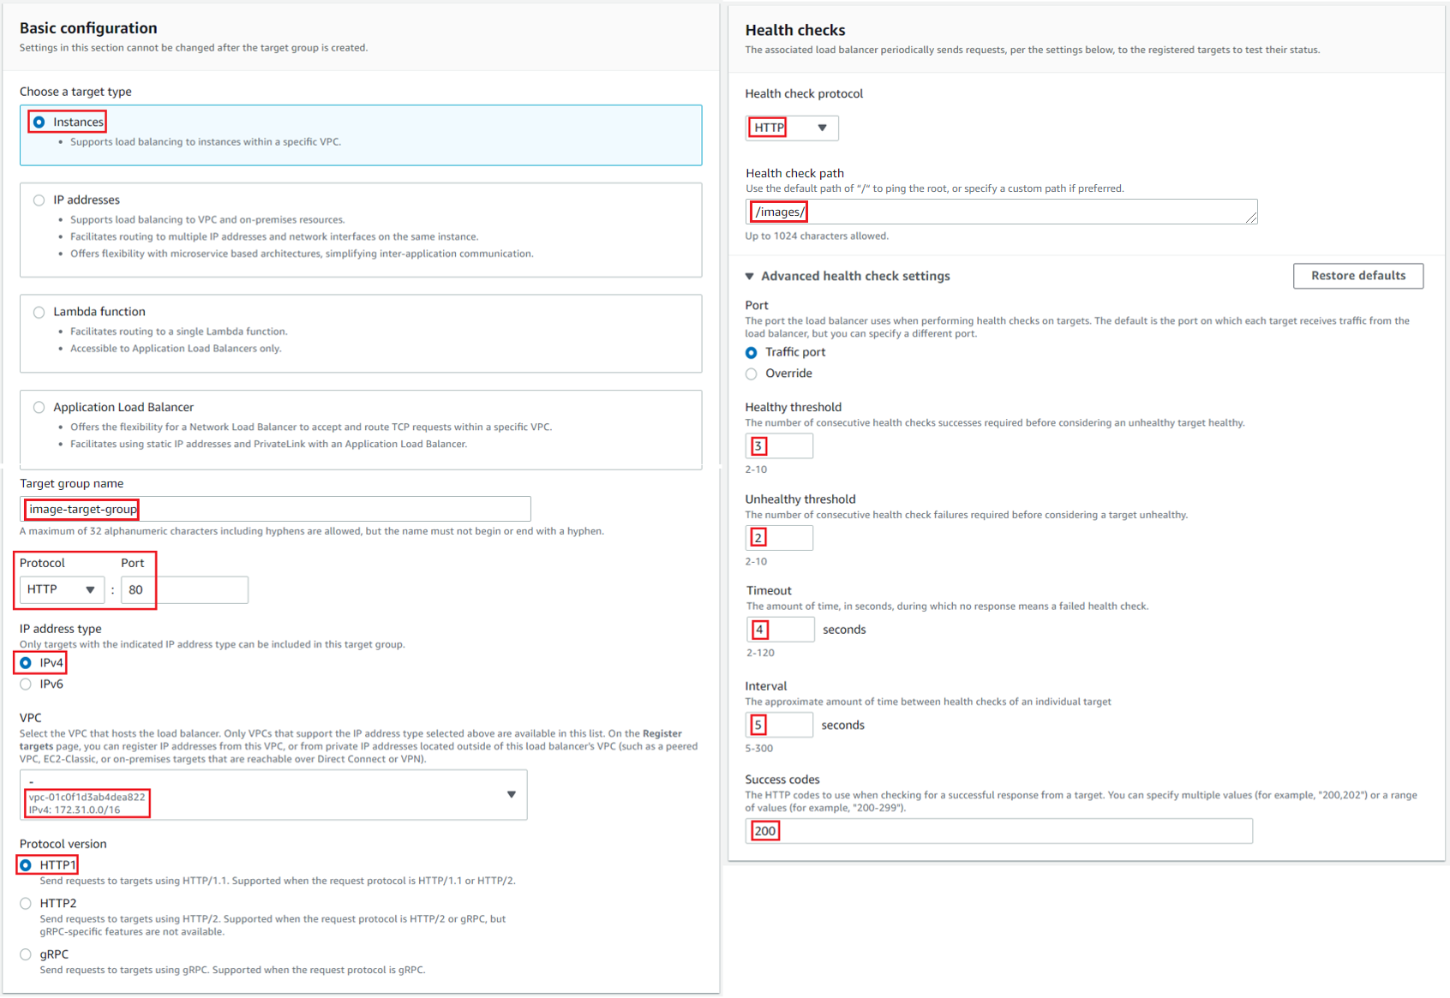
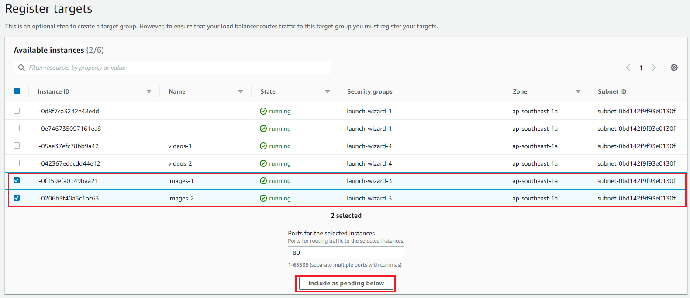
Elastic Load Balancing Service
Create image & video Target Group
Image Target Group

Slide 24

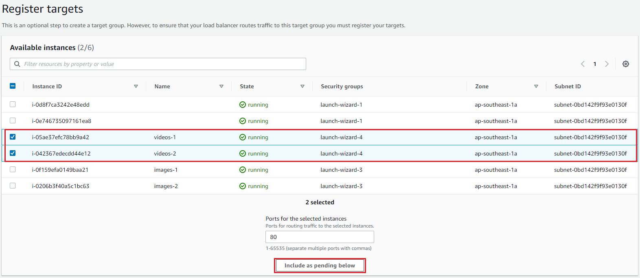
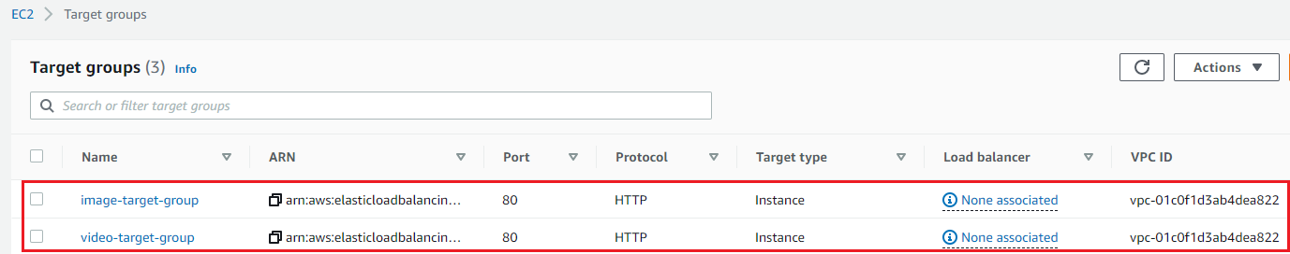
Elastic Load Balancing Service
Video Target Group

Slide 25
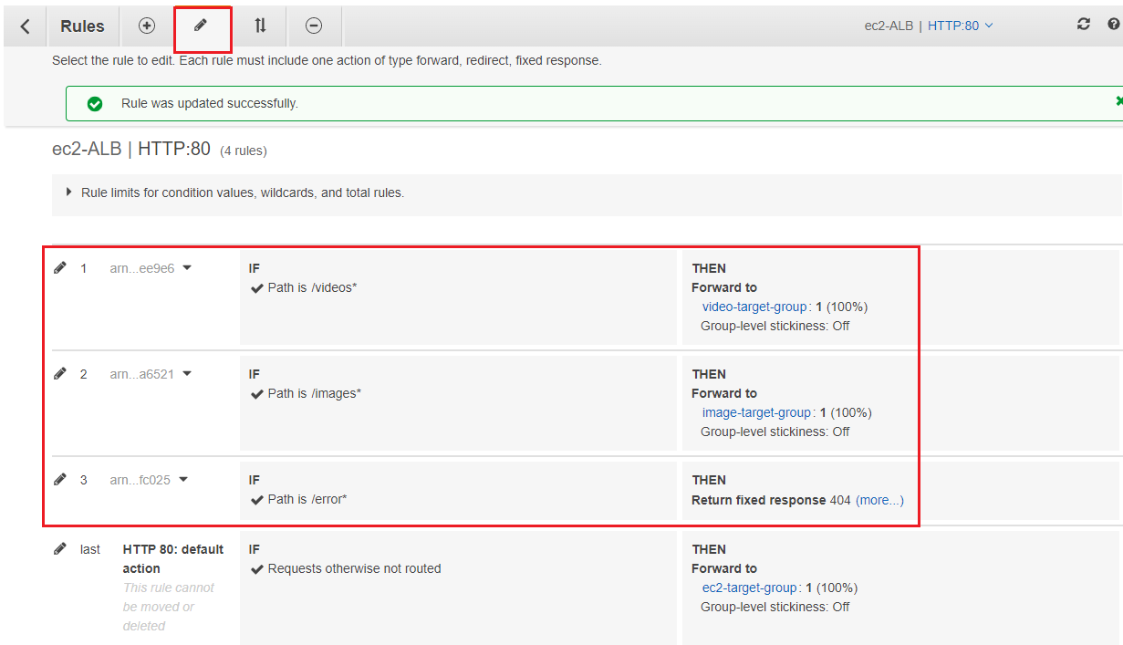
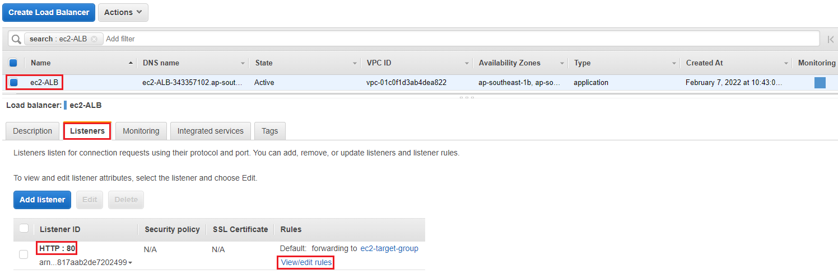
Elastic Load Balancing Service
Create Load Balancer
Add Listener to Load Balancer

Slide 26
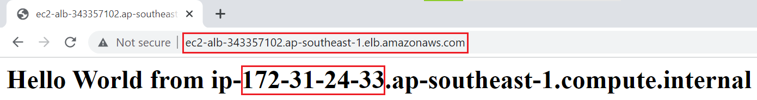

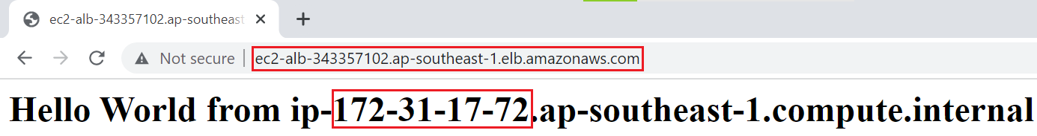

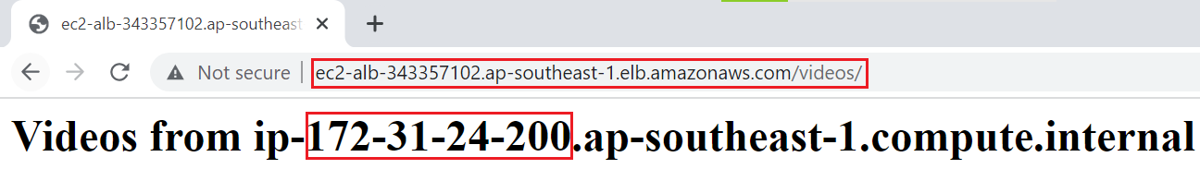
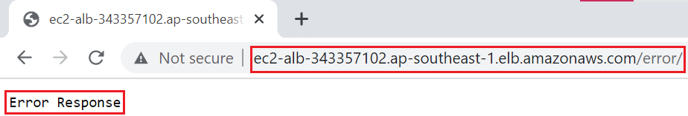
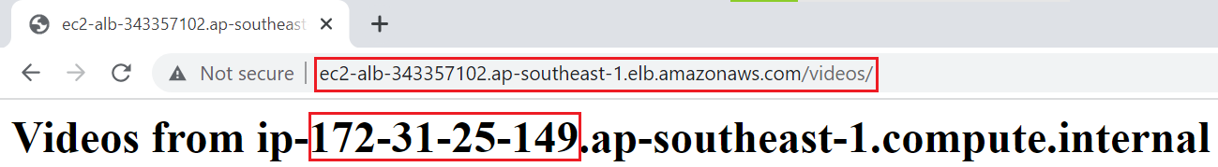
Elastic Load Balancing Service
Test
Ec2 Target Group
Image Target Group
Error page
Video Target Group

Slide 27
Assignment
Self-practice

Slide 28
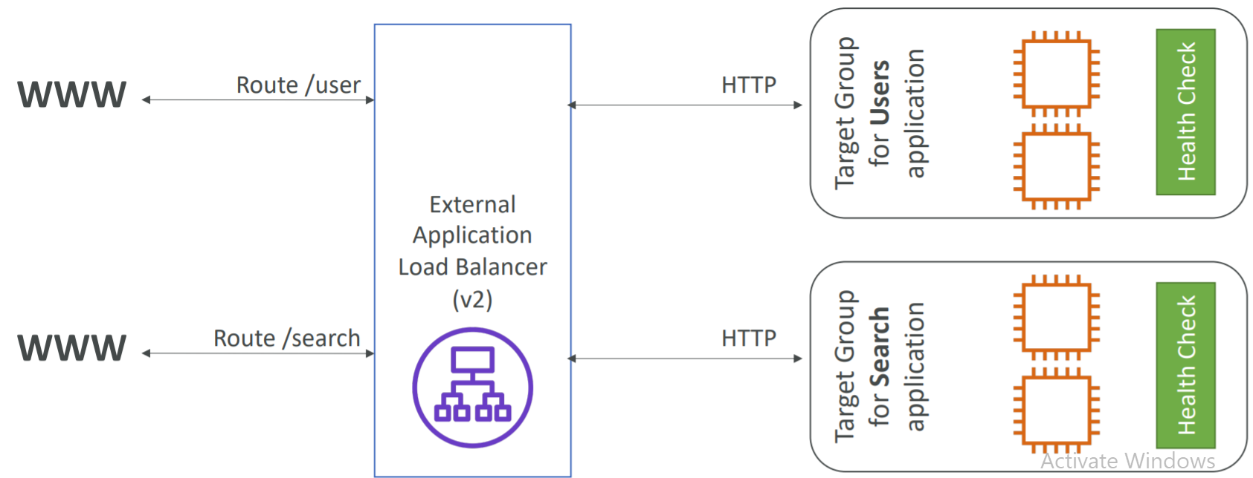
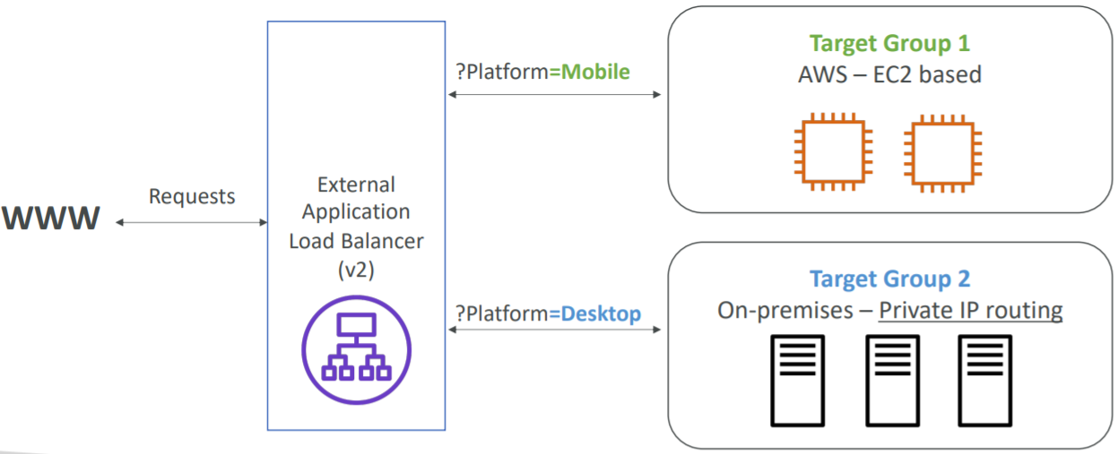
Elastic Load Balancing Service
Listener
Define rules for mapping requests with target groups, fixed response
Including: Protocol (HTTP/HTTPS) & port, rules
Routing tables to different target groups:
Routing based on path in URL (example.com/users & example.com/posts)
Routing based on hostname in URL (one.example.com & other.example.com)
Routing based on Query String, Headers (example.com/users?id=123&order=false)
Path URL
Query String

Slide 29
Elastic Load Balancing Service
Listener

Slide 30

Elastic Load Balancing Service
Usecases
Hybrid load balancing
Application running on on-premises & AWS VPC (Config Instance running on on-premises via source IP)
Host-based routing & Path-based routing (Ex: microservices, docker, ...)

Slide 31


Elastic Load Balancing Service
Load Balancer
Distribute traffic to multiple targets across multiple zones (based on rules of listeners)
Schema
Internet-facing (public): Routing internet requests to targets
Internal (private): Routing internal requests to targets using private IP addresses.
Components
Schema

Slide 32



Elastic Load Balancing Service
Security group
Internet-facing
Internal

Slide 33

Elastic Load Balancing Service
Network: you should specify subnets in multiple different zones to increase high availability

Slide 34
Elastic Load Balancing Service
IP
No fixed IP 🡺 accessing via domain (XXX.region.elb.amazonaws.com)
The IP address of the incoming client request will change as it passes through the ALB
The header inserted true IP of the client (X-Forwarded-For), Port (X-Forwarded-Port) proto (X-Forwarded-Proto)
Support both Ipv4 & Ipv6

Slide 35


Elastic Load Balancing Service
Deletion protection
Idle timeout
Each request will include 2 parts: from client to load balancer and from load balancer to target
For long time tasks (ex: upload file, ..) you will have to send at least 1 byte of data to avoid closing the connection
Access logs: save log in S3

Slide 36


Elastic Load Balancing Service
SSL/TLS certificate (for HTTPS)
An SSL Certificate allows traffic between your clients and your load balancer to be encrypted in transit (in-flight encryption)
SSL stands for Secure Sockets Layer, used to encrypt connections
TLS stands for Transport Layer Security, which is a newer version
The load balancer uses an X.509 certificate
ALB can attach multiple SSL certificates

Slide 37


Elastic Load Balancing Service
Listener
Including: Protocol (HTTP/HTTPS) & port & rules
Cross-zone load balancing
Ensure traffic goes evenly through all targets
Always enable
You can add multiple listener
No cross-zone load balancing
Cross-zone load balancing

Slide 38

Elastic Load Balancing Service
Integrated services:
Global Accelerator: ALB only works on 1 region 🡺 Integrated Global Accelerator Service to ALB can work on multiple regions
Route 53: providing Domain for ALB, support multiple Domains
Auto Scaling Group
Global Accelerator + ALB
ALB + Auto Scaling Group

Slide 39

Elastic Load Balancing Service
Monitoring via CloudWatch & CloudTrail
Monitoring

Slide 40

Elastic Load Balancing Service
Summary
Flow

Slide 41
Assignment
Self-practice

Slide 42

Elastic Load Balancing Service
Network Load Balancer (NLB)
Working at layer 4 – transport layer of OSI Model (TCP/UDP/TLS)
High performance
Can handle millions of requests per second, Less latency ~100 ms (vs 400 ms for ALB)
More expensive than ALB
Fixed IP
The IP address of the incoming client request will unchange as it passes through the NLB

Slide 43
Elastic Load Balancing Service
Usecases: Applications that ALB does not support, High performance application
TCP/UDP traffic
Legacy applications that implement custom protocol.
NTP servers, SMTP server, Database servers.
MQTT brokers
High performance queue servers (ActiveMQ, RabbitMQ, ZeroMQ, ...)
Message processing applications (think Kafka, co)
Real-time applications (ex: video streaming, stock, ..)

Slide 44
Elastic Load Balancing Service
Demo
https://www.youtube.com/watch?v=jKnvCm-uV9o
Components
Target
Target group
Listener
Load balancer
Similar to ALB

Slide 45

Elastic Load Balancing Service
Target
Only support Instance, IP, ALB (not support Lambda Function)
Load balancer
Support VPC peering connection, VPN, Direct Connect

Slide 46
Assignment
Self-practice

Slide 47


Elastic Load Balancing Service
Gateway Load Balancer (GLB)
Easily deploy, scale, and manage a fleet of third-party virtual appliances
Virtual appliances are tools in front of the instances (ex: firewall, DDoS Prevention, analytic tool, ...)
Working at layer 3 - network layer of OSI Model
Tutorial: https://www.youtube.com/watch?v=-j2smz_VCH4

Slide 48


Elastic Load Balancing Service
Usecases: Link
Demo: https://www.youtube.com/watch?v=f4DduW2M5WI
Flow

Slide 49
Assignment
Self-practice

Slide 50

Elastic Load Balancing Service
Classic Load Balancer (CLB)
Working at both layer 4 – transport layer & layer 7 – application layer of OSI Model (HTTP/HTTPS & TCP/UDP/TLS)
Support classic-EC2
Full features of ALB and NLB
Old 🡺 instead of ALB & NLB
Tutorial: https://www.youtube.com/watch?v=N1DQgV1j-ps

Slide 51
Elastic Load Balancing Service
Comparing
https://aws.amazon.com/elasticloadbalancing/features/#Product_comparisons

Slide 52
Summary
High Availability means running your application / system in at least 2 Availability Zones
ELB automatically distribute traffic from the client to many different targets on more zones
4 types: ALB, NLB, GLB, CLB
ALB: Working at layer 7 - HTTP/HTTPS, accessing via domain, using for Web Application, Microservices, Hybrid load balancing, …
NLB: Working at layer 4 - TCP/UDP/TLS, expensive than ALB, Support VPC peering connection, VPN, Direct Connect, using for Applications that ALB does not support, High performance applications
CLB: Working at both layer 4 & layer 7, support classic-EC2, full features of ALB and NLB, Old

Slide 53
Summary
Component: Load balancer (Internet-facing/Internal), Listener (protocol& port, rules), Target group (health check), Target (EC2, IP, Lambda function)
Integrated services: Global Accelerator, Route 53, Auto Scaling Group

Slide 54
Q & A
Copyright © VTI Academy All Rights Reserved

